Slide 1

SMART INDIA HACKATHON 2026
TITLE PAGE
Problem Statement ID – SIH26192
Problem Statement Title- Flash Flood Prediction System for Hilly Regions using Multi-Source Data Theme.
Theme- Disaster Management
PS Category- Software
Team ID-
Team Name- Elites

Slide 2
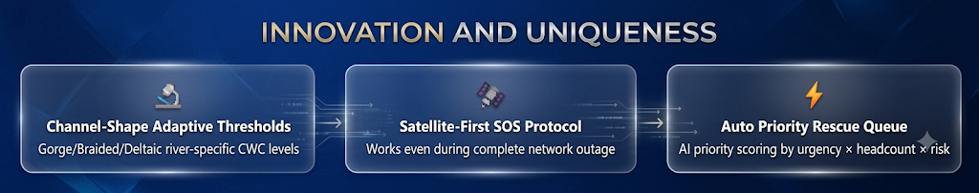
IDEA TITLE
Elites
The Problem
Our Solution
Flash floods in Himalayan basins strike within minutes of cloudburst — zero lead time
Traditional downstream gauge systems miss upstream gorge funneling dynamics
No unified multi-source platform (rain + river + soil + DEM)
4,000+ lives lost annually to floods in India (NDMA 2023)
Cellular blackout prevents SOS signals during peak disaster
Rescue dispatch is manual, slow, and lacks priority scoring.
Multi-source risk engine: Rainfall + River Rise + CWC Thresholds + Soil Saturation + DEM slope
28+ real Indian rivers registered with CWC gauge threshold bands
Automatic danger breach detection → instant SMS alerts + rescue priority queue
Satellite SOS: 128-byte compressed binary packet — works with ZERO cellular
GIS interactive risk map with real-time rescue lifecycle tracking
RBAC portal for Citizens, Rescue Teams, Govt & Admins.

Slide 3
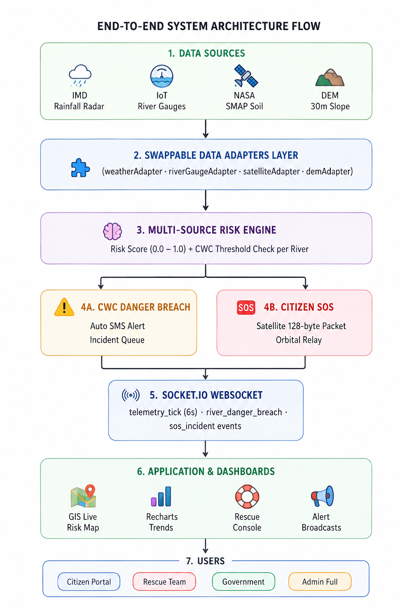
TECHNICAL APPROACH
Elites
Technology Stack
Layer | Technology
Frontend | React 18 + TypeScript + Tailwind CSS
Maps | Leaflet.js (react-leaflet) + GeoJSON
Charts | Recharts (AreaChart, BarChart, RefLines)
Backend | Node.js + Express + TypeScript
Real-time | Socket.IO WebSockets (6-sec ticks)
Auth | JWT + RBAC Middleware
DB (prod) | PostgreSQL + PostGIS + Redis
Deploy | Docker Compose (client:3000, server:5000

Slide 4
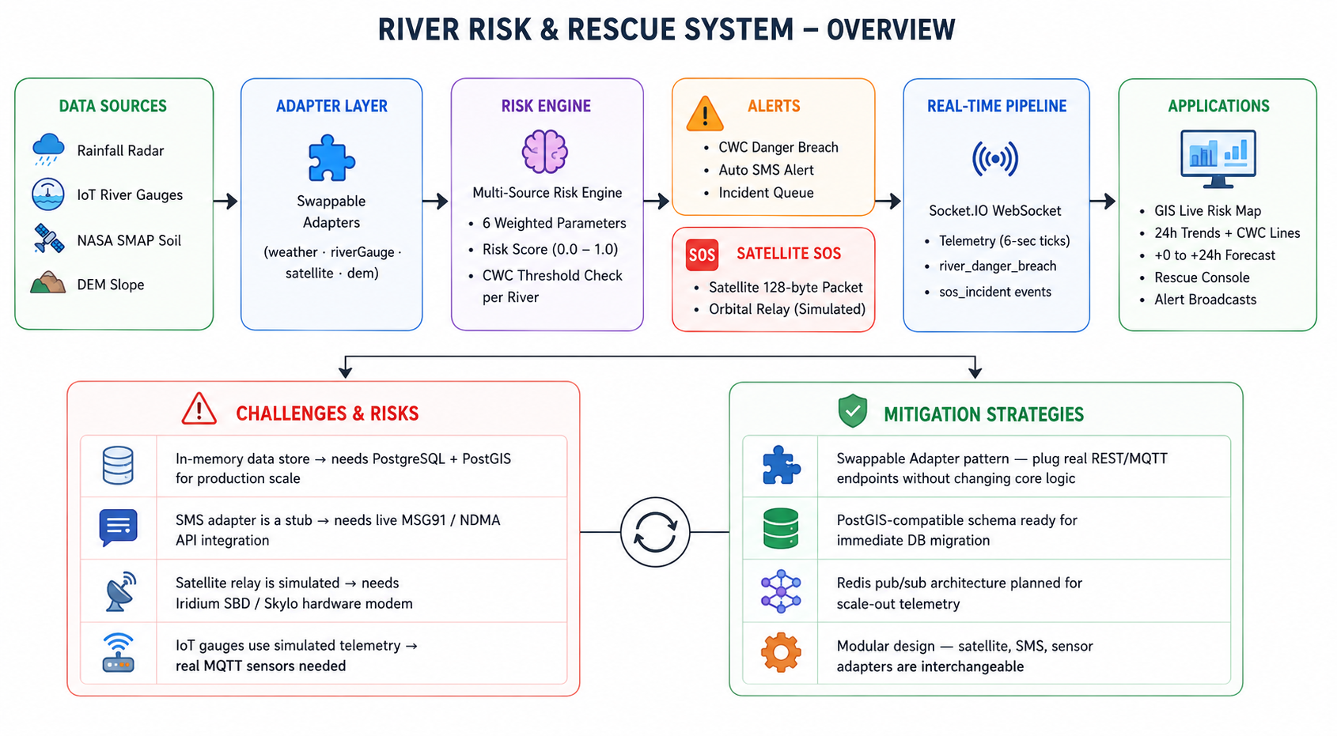
FEASIBILITY AND VIABILITY
Elites

Slide 5
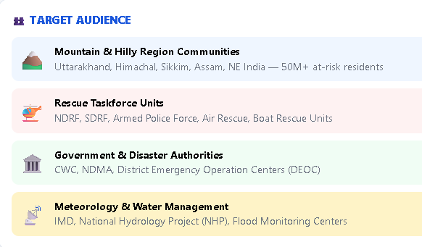
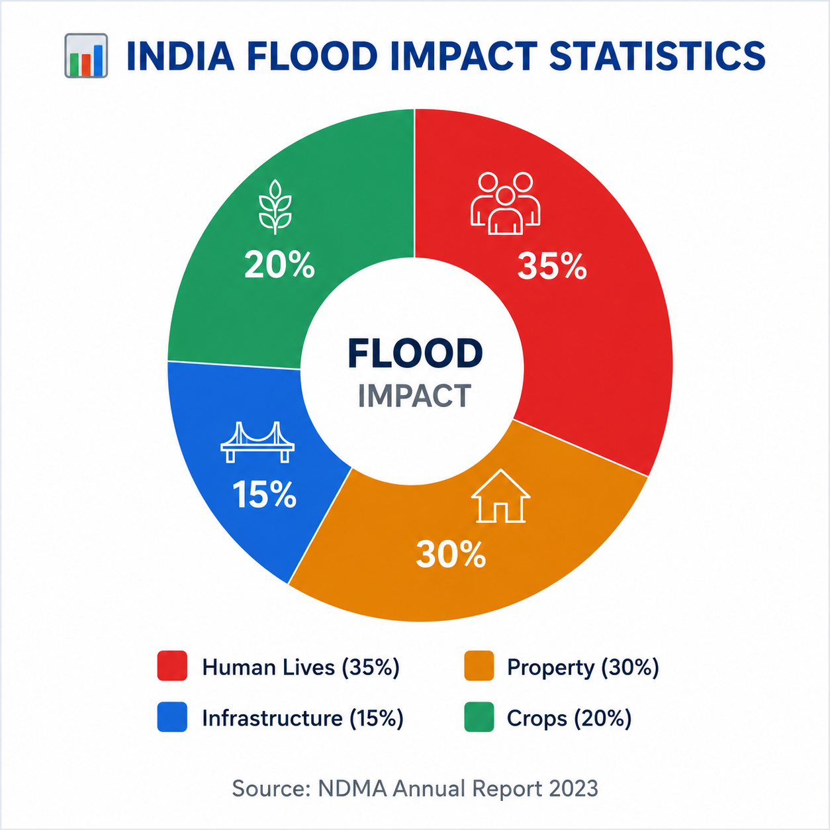
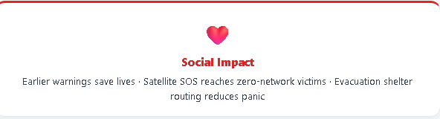
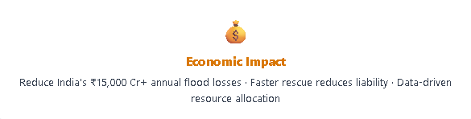
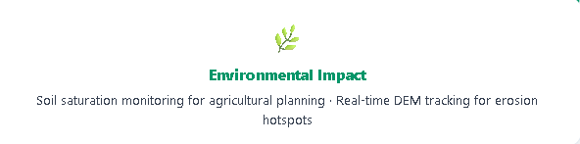
IMPACT AND BENEFITS
Elites

Slide 6
RESEARCH AND REFERENCES
Your Team Name
Details / Links of the reference and research work

Slide 7
IMPORTANT INSTRUCTIONS
Please ensure below pointers are met while submitting the Idea PPT:
Kindly keep the maximum slides limit up to six (6). ( Including the title slide)
Try to avoid paragraphs and post your idea in points /diagrams / Infographics /pictures
Keep your explanation precise and easy to understand
Idea should be unique and novel.
You can only use provided template for making the PPT without changing the idea details pointers (mentioned in previous slides).
You need to save the file in PDF and upload the same on portal. No PPT, Word Doc or any other format will be supported.
Note - You can delete this slide (Important Pointers) when you upload the details of your idea on SIH portal.

